Slide 1
The cloud foundry deployment process
1.Prepare for deployment
2.Know your credentials and target
3.Determine deployment options
4.Push the app
5.Troubleshoot problems

Slide 2
Prepare for deployment
Is the app cloud ready
Have extraneous files and artifacts been excluded
Has an instance of every service that the app requires been created
Does your Cloud Foundry instance (i.e. Bluemix) support the type of app you are going to deploy?
  If not, do you have the URL of an externally available buildpack that can stage the app?
1.Prepare for deployment

Slide 3
Know your credentials and target
Do you know your Bluemix id and password?
Do you know the cloud foundry (Bluemix) api endpoint that you are deploying to?
Do you know the organization and space that you will be deploying to?
2.Know your credentials and target

Slide 4
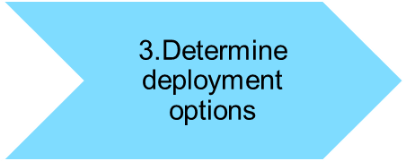
Determine deployment options
Have you selected a unique name for your app?
Have you determined the number of instances you will need to run?
Do you the maximum memory limit for your app?
Do you know what services your app requires?

Slide 5
Push the app
Have you configured app name, number of instances, memory, services, etc in your manifest file?
4.Push the app

Slide 6
Troubleshoot deployment problems
Have you ensured that the app can run locally?
5.Troubleshoot problems

